Slide 1
Keyloggers and security
CAPSTONE PROJECT
Presented By:
1. Saranya V - VV College of Engineering - Computer Science and Engineering

Slide 2
OUTLINE
Problem Statement (Should not include solution)
Proposed System/Solution
System Development Approach (Technology Used)
Algorithm & Deployment
Result (Output Image)
Conclusion
Future Scope
References

Slide 3
Problem Statement
In today's digital age, where cybersecurity threats loom large, one of the significant concerns is the proliferation of keyloggers, stealthy software tools designed to monitor and record keystrokes on a user's computer without their knowledge. Keyloggers pose a severe threat to individuals and organizations as they can capture sensitive information such as passwords, credit card details, and other personal data, leading to identity theft, financial loss, and privacy breaches.

Slide 4
Proposed Solution
Keyloggers are software tools designed to record keystrokes on a computer or device without the user's knowledge, which can be used for malicious purposes such as stealing sensitive information like passwords, credit card numbers, or personal messages.
Data Collection:
Gather a diverse dataset of keystrokes, including legitimate user input and potential keylogger-generated input.
Timestamps are crucial for analyzing the sequence and timing of user input, as well as for reconstructing user activities over time.
Data Preprocessing:
Remove any irrelevant or noisy data from the keystroke logs. This may include removing special characters, formatting inconsistencies, or any entries that do not contribute to the analysis.
Extract relevant features from the keystroke data, such as typing speed, key frequency, or patterns of keystrokes.
Machine Learning Algorithm:
Random Forests are ensemble learning methods that can be used for both classification and regression tasks in keyloggers.
SVMs are commonly used for binary classification tasks in keyloggers, such as distinguishing between legitimate user behavior and malicious activity.
Deployment:
Clearly define the objectives of deploying the keylogger and determine the scope of monitoring, including what types of activities will be logged and for what duration.
Implement measures to protect the privacy and security of the logged data, such as encryption, access controls, and secure storage practices.
Evaluation:
Measure the accuracy of the keylogger in capturing keystrokes without missing or misinterpreting them.
Assess the efficiency of the keylogger in terms of resource usage (CPU, memory, disk space) and its impact on system performance.
Result:

Slide 5
System Approach
The "System Approach" section outlines the overall strategy and methodology for developing and implementing the rental bike prediction system. Here's a suggested structure for this section:
System requirements
Python IDLE
Library required to build the model
pynput
json

Slide 6
Algorithm & Deployment
In the Algorithm section, describe the machine learning algorithm chosen for predicting bike counts. Here's an example structure for this section:
Algorithm Selection:
Hidden Markov Models (HMMs), Gaussian Mixture Models (GMMs), Recurrent Neural Networks (RNNs). These models can capture temporal dependencies and identify user-specific typing patterns.
Data Input:
Keyloggers intercept keyboard events, capturing each keystroke made by the user. This includes alphanumeric characters, special keys (e.g., Enter, Backspace), function keys, and any other input provided via the keyboard.
Training Process:
Gather a dataset of labeled keystroke data. This dataset should include examples of keystrokes along with their corresponding labels, such as legitimate user input or malicious activity.
Prediction Process:
Input the preprocessed keystroke data into the trained machine learning model or algorithm. Use the model to predict the class or label of each keystroke.

Slide 7

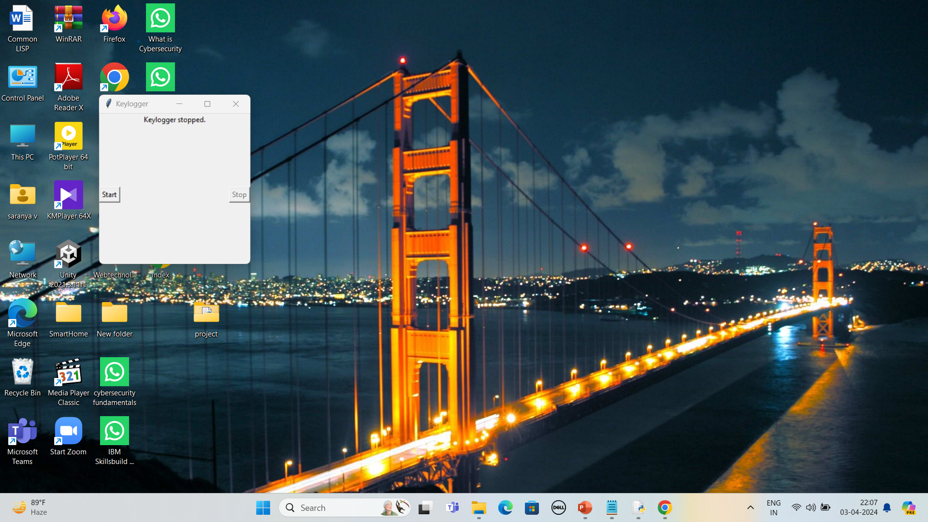
Result

Slide 8
Conclusion
Keyloggers play a significant role in various contexts, ranging from legitimate uses such as parental control and employee monitoring to potential malicious activities like identity theft and unauthorized access. Keyloggers should be deployed and used responsibly, with clear objectives aligned with legal and ethical standards. Consent should be obtained when monitoring devices that are not owned by the user.

Slide 9
Future scope
The future scope for keyloggers is multifaceted, driven by advancements in technology, changing user behaviors, and evolving security threats. Keyloggers could be integrated into more advanced security solutions to protect against sophisticated cyber threats. With the proliferation of Internet of Things (IoT) devices, there will be a growing need for keyloggers capable of securing IoT ecosystems. Keyloggers could be integrated into IoT security solutions to monitor and analyze device activity, detect unauthorized access attempts, and prevent IoT-related cyber threats. Advanced algorithms can adapt to evolving threats, identify new attack vectors, and provide real-time threat intelligence. Keyloggers may evolve to support multiple platforms and operating systems, including desktops, mobile devices, and cloud-based applications.

Slide 10
References
Monrose, F., Rubin, A. D., & Kobsa , A. (Eds.). (2011). Principles of Secure Information Systems Design. Springer Science & Business Media.
Li, W., & Zhou, Z. (2015). Keystroke Dynamics. Springer.
Monrose, F., & Rubin, A. D. (2000). Keystroke dynamics as a biometric for authentication. Future Generation Computer Systems, 16(4), 351-359.
Porras, P., & Saidi, H. (2007). A security analysis of windows NT's symmetric cryptography. ACM Transactions on Information and System Security (TISSEC), 5(2), 166-207.
Sood, A. K., Enbody, R. J., & Bansal, R. (2013). Advanced persistent threats: detection, protection, and prevention. Syngress.
SANS Institute. (n.d.). Keyloggers. Retrieved from https://www.sans.org/security-resources/keyloggers
Symantec. (n.d.). Keylogger. Retrieved from https://www.symantec.com/security-center/writeups

Slide 11
THANK YOU

